Slide 1
Plant Disease Recognition
Using Convolutional Neural Network
Group 9:
Deen Huang
Varsha Waingankar
Yupeng Yang

Slide 2
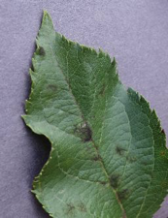
Problem Statement
The diagnosis of pests and diseases is essential for agricultural production. This crops disease recognition competition invited participants to design algorithms and models to recognise species and diseases in the crop leaves.
Apple_Scab general

Slide 3
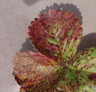
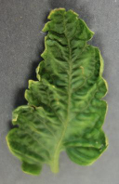

Images Dataset
Different heights
Different widths
Different names
Original images examples:

Slide 4
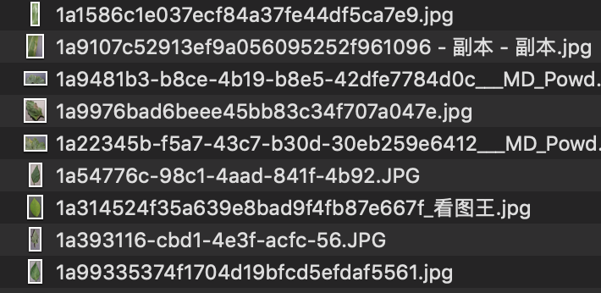
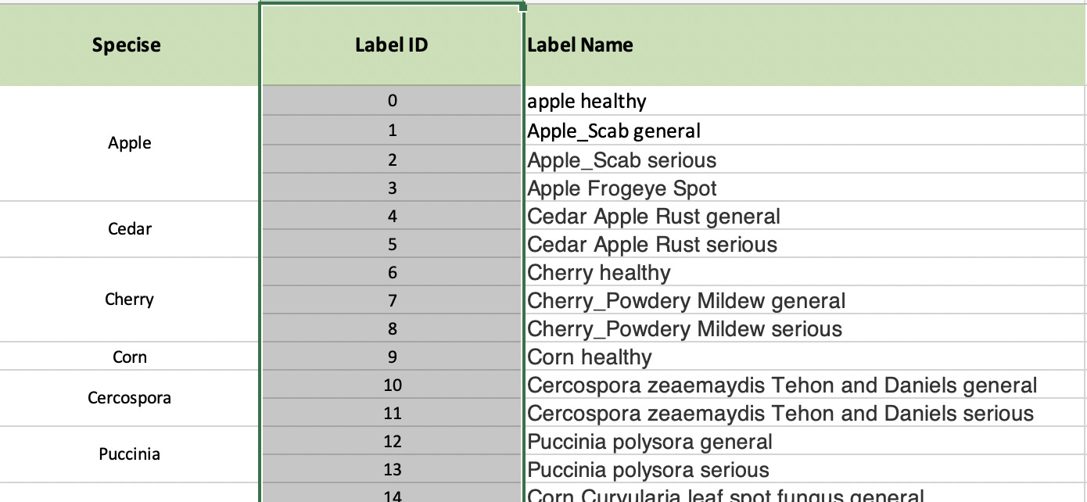
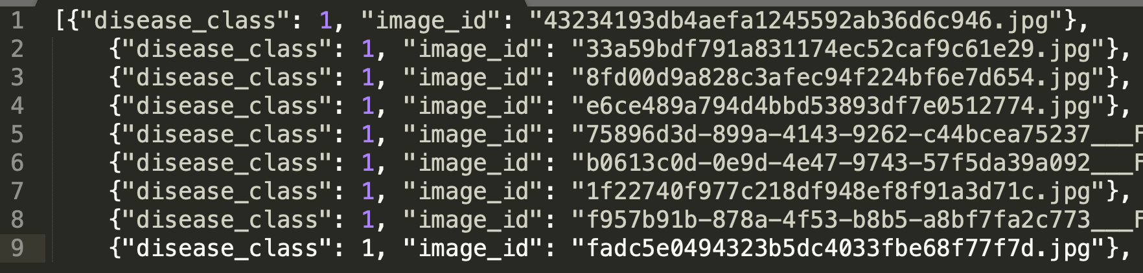
Data Processing (merge):
1.Original Images:
3.Label table:
2. Annotations json file:

Slide 5
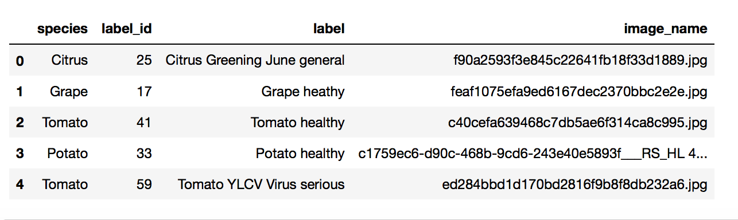
Processing Json Annotations File
Create a pandas dataframe by reading the label table file
Assign column names to the data frame. [disease_id ,label, species]
From the json file import disease id and respective image names. Merge this with the previous data frame
Result:

Slide 6
Neural Network Model
Building an effective neural network model requires careful consideration of
Input data format
Network Architecture

Slide 7
Data Formatting
The most common image data input parameters are the number of images, image height, image width, number of channels, and number of levels per pixel. Typically we have 3 channels of data corresponding to the colors Red,Green, Blue (RGB) Pixel levels are usually [0,255] .
Uniform aspect ratio: One of the first steps is to ensure that the images have the same size and aspect ratio. Cropping the images
Image Scaling: Once we’ve ensured that all images are square (or have some predetermined aspect ratio), it’s time to scale each image appropriately. We’ve decided to have images with width and height of 128 pixels.
Normalizing image inputs: Data normalization is an important step which ensures that each input parameter (pixel, in this case) has a similar data distribution. This makes convergence faster while training the network. The normalized data in the range [0 to 255]

Slide 8
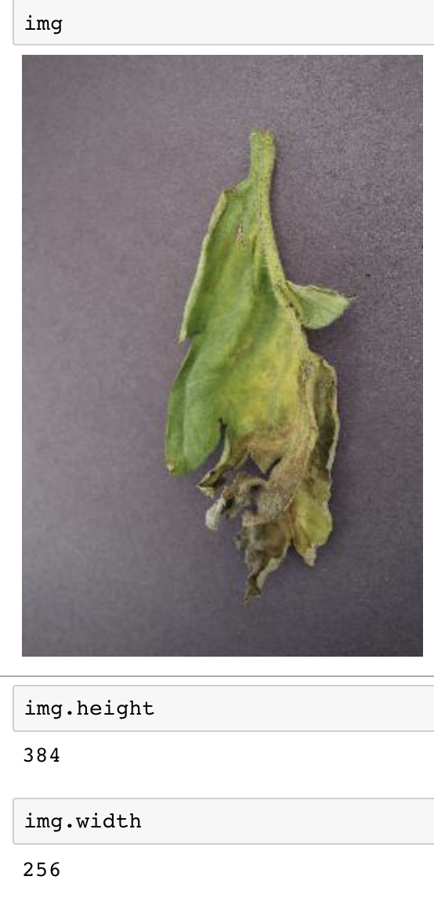
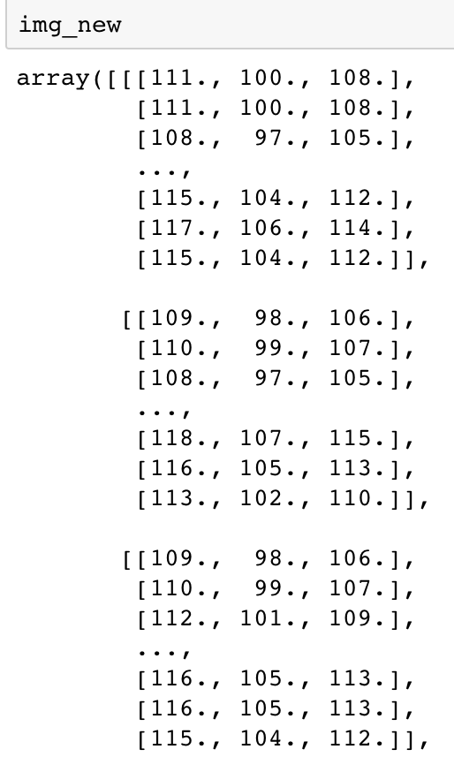
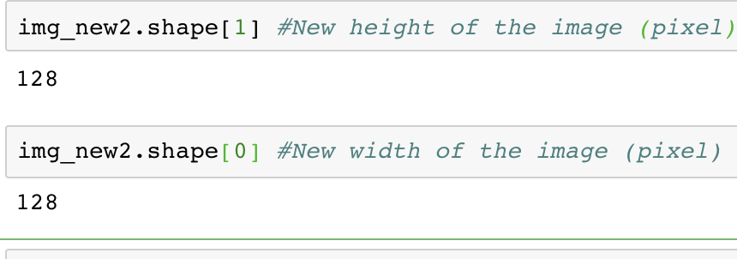
Image Resize
Converted each image to an array
First step: Ensure that the images have the same size and aspect ratio (most of the neural network models assume a square shape input image).
Image data resized results:
number of images: 31718
image height: 128
image width: 128
number of channels: RGB [0, 255]
number of species: 14
number of labels: 61
Before
After

Slide 9
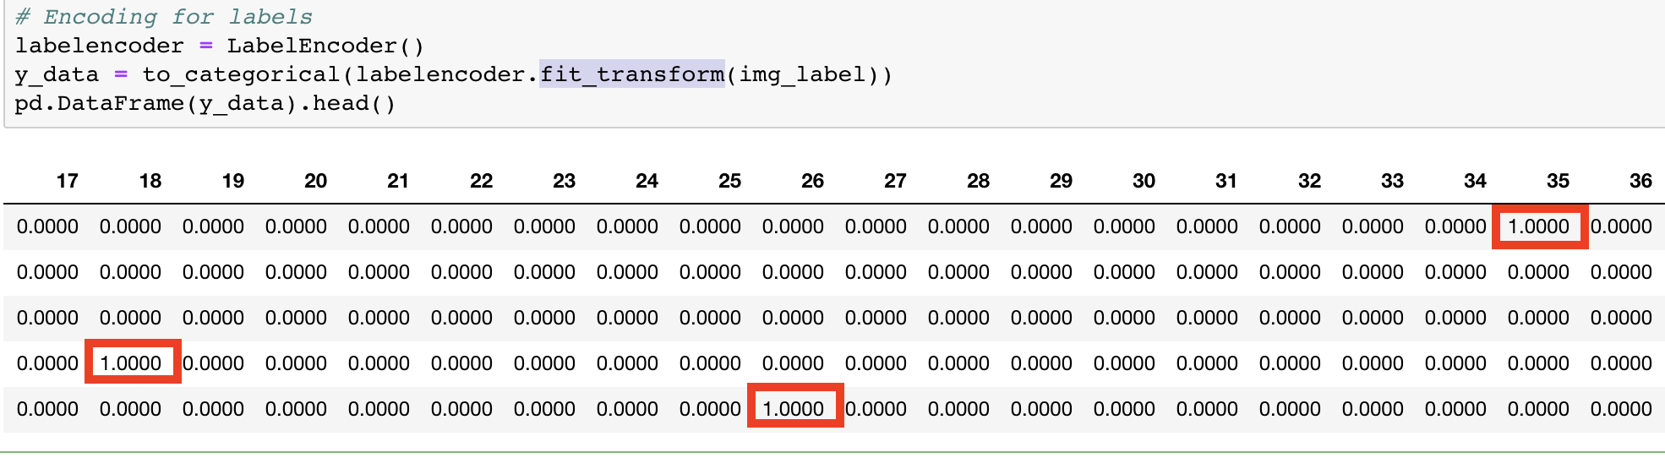
Encoding for 61 labels...
“one-hot encoded” vector

Slide 10
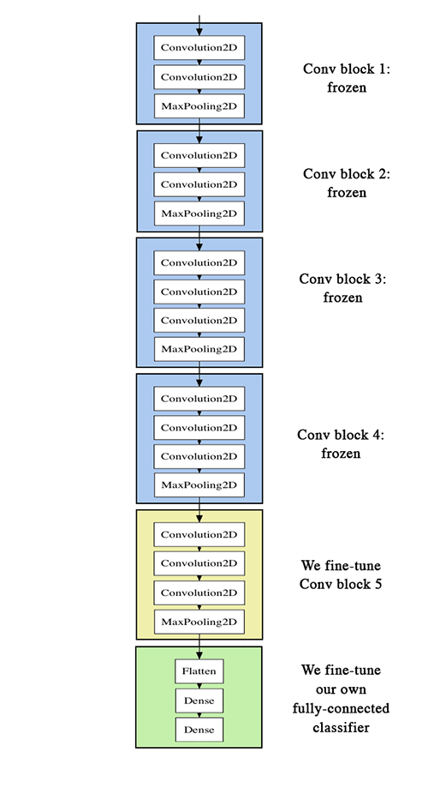
Network Architecture (VGG)
Provide input image into convolution layer
Choose parameters, apply filters with strides and padding. Perform convolution on the image and apply ReLU activation function to the matrix (deal with vanishing gradient).
Perform pooling to reduce dimensionality size
Add as many convolutional layers until satisfied
Flatten the output and feed into a fully connected layer /dense (FC Layer)
Output the class using an activation function (softmax) and classifies images.
Notes:
Stride is a metric for regulating the movement of various convolutional filters for pixel-wise operations across a given image space. For example, if stride is three, there will be three pixels between each subsequent sample.
padding, to show exactly how each filter or layer will treat an image or a portion of an image.

Slide 11
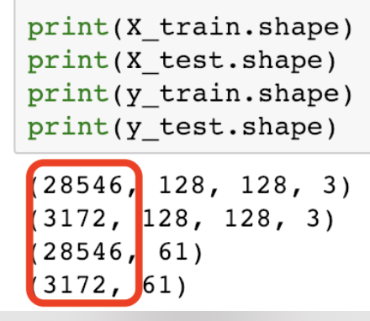
Train/Test Split
The name x refers to input data, while the name y refers to the labels.
Training data is the data our model learns from.
Test data is kept secret from the model until after it has been trained. Test data is used to evaluate our model.

Slide 12
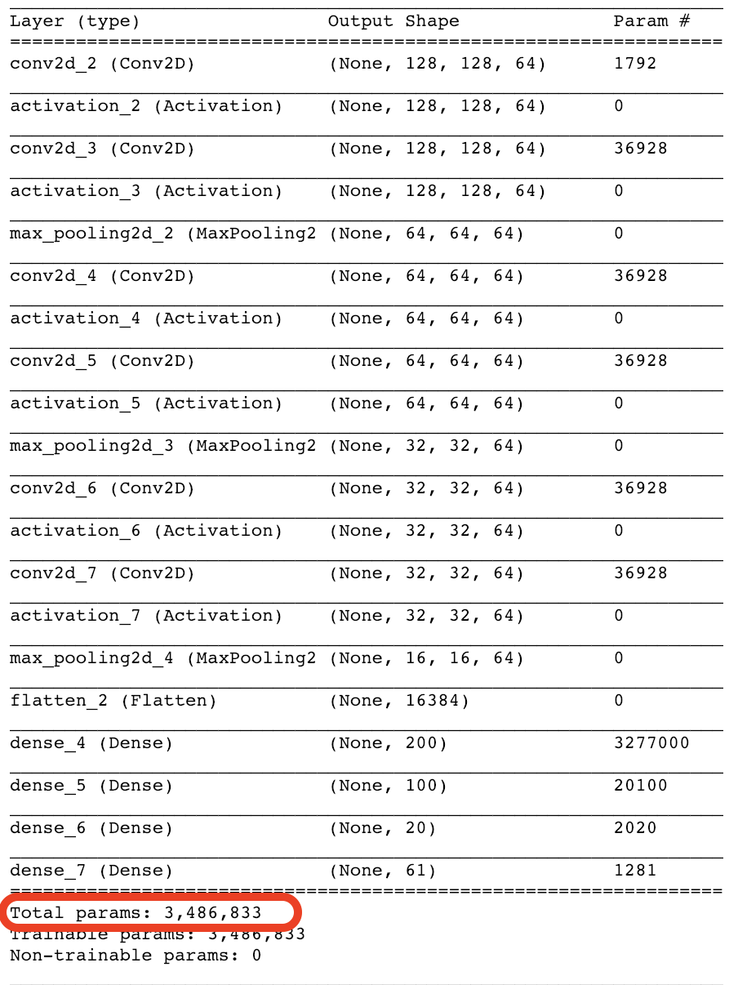
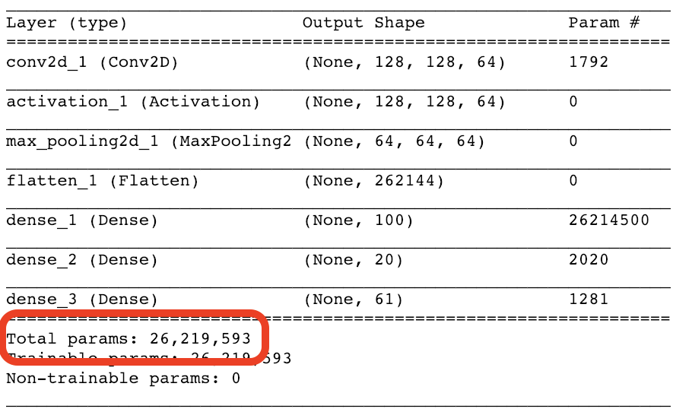
Basic CNN vs. Deeper CNN
Number of Parameters

Slide 13
Reason for the parameters reduction
After a convolution layer, it is common to add a pooling layer in between CNN layers. The function of pooling is to continuously reduce the dimensionality to reduce the number of parameters and computation in the network. This shortens the training time and controls overfitting. The most frequent type of pooling is max pooling, which takes the maximum value in each window. These window sizes need to be specified beforehand. This decreases the feature map size while at the same time keeping the significant information.

Slide 14
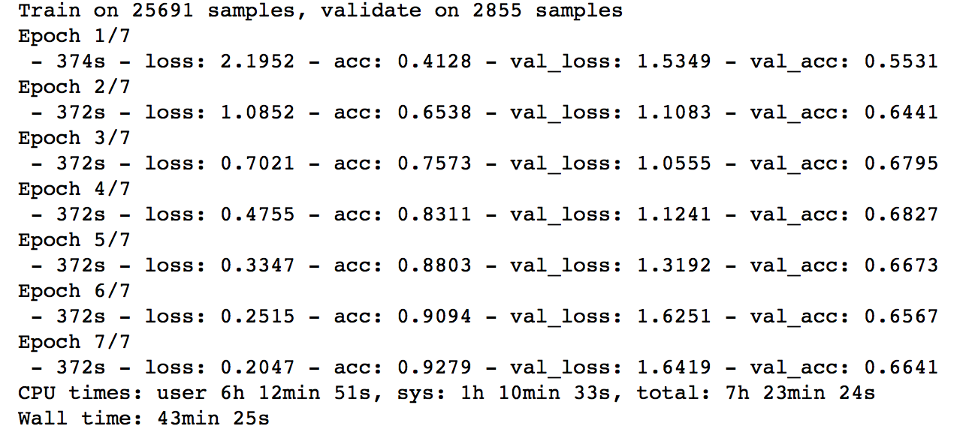
Train and validation accuracy on basic_cnn model

Slide 15
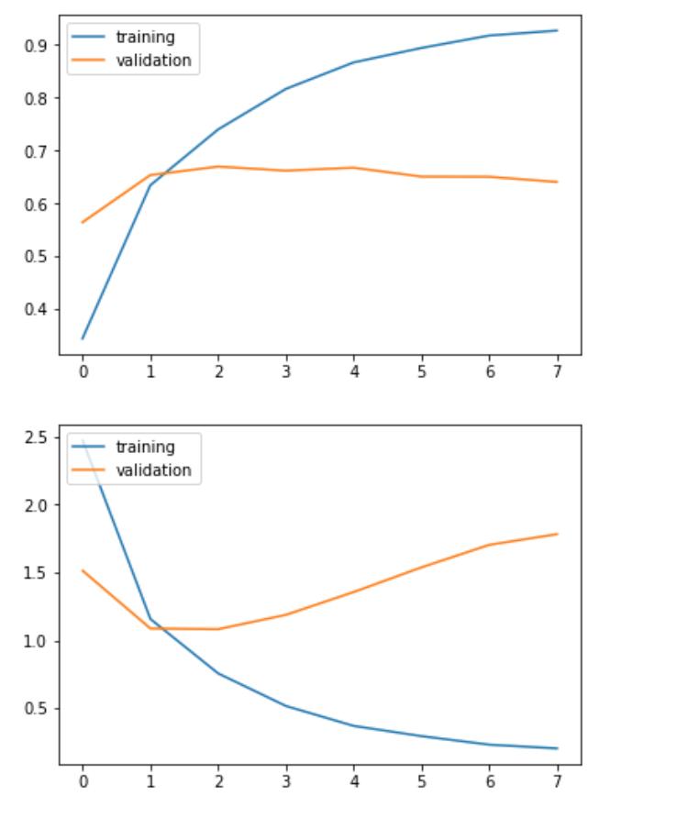
Accuracy vs loss basic cnn

Slide 16
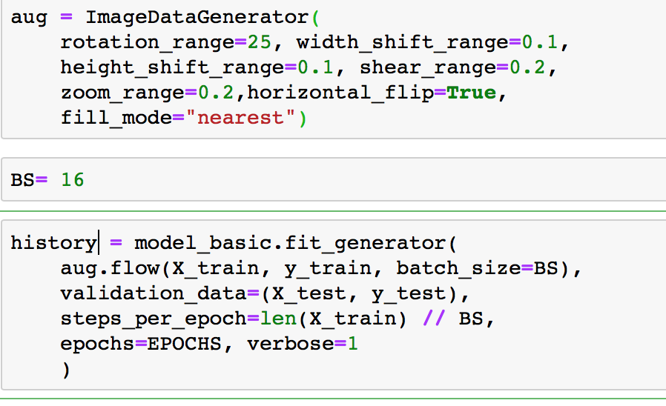
Data Augmentation
transform_parameters: Dictionary with string - parameter pairs describing the transformation. Currently, the following parameters from the dictionary are used:
'theta': Float. Rotation angle in degrees.
'tx': Float. Shift in the x direction.
'ty': Float. Shift in the y direction.
'shear': Float. Shear angle in degrees.
'zx': Float. Zoom in the x direction.
'zy': Float. Zoom in the y direction.
'flip_horizontal': Boolean. Horizontal flip.
'flip_vertical': Boolean. Vertical flip.
'channel_shift_intencity': Float. Channel shift intensity.
'brightness': Float. Brightness shift intensity.
Notes:
This makes it less likely that the neural network recognizes unwanted characteristics in the data-set. This helps prevent overfitting and helps the model generalize better. fit_generator, evaluate_generator and predict_generator.

Slide 17
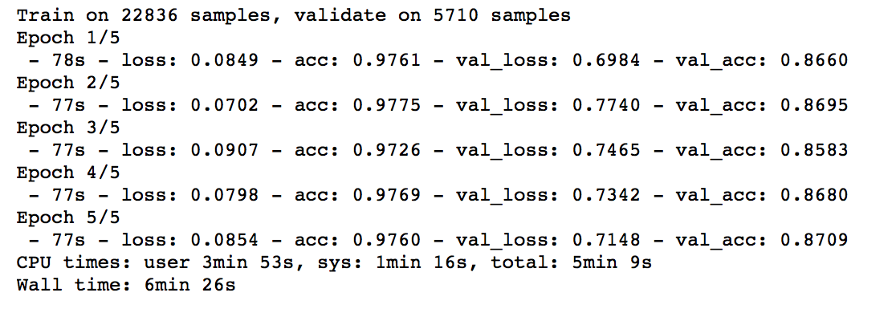
Train and validation accuracy on deep_cnn model

Slide 18
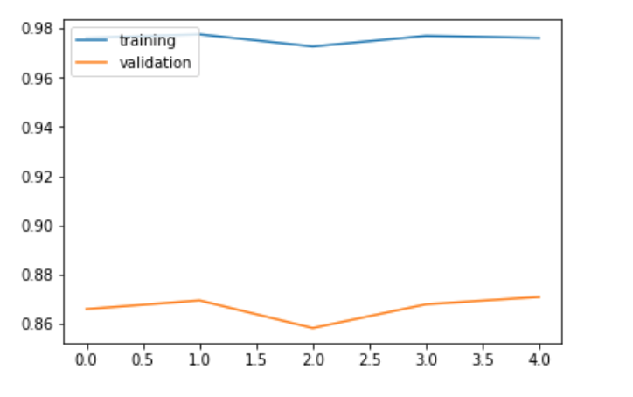
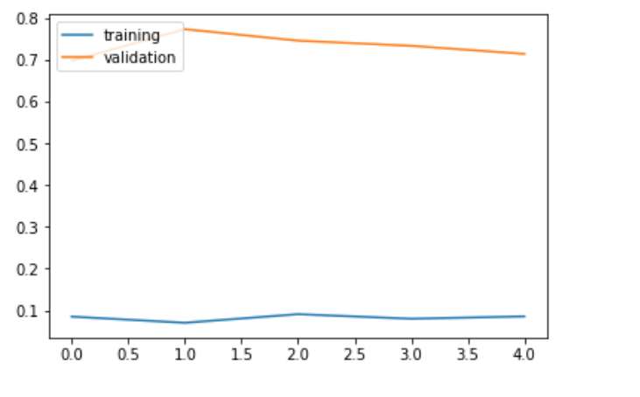
Accuracy vs Loss Deep cnn

Slide 19

AWS Setup

Slide 20
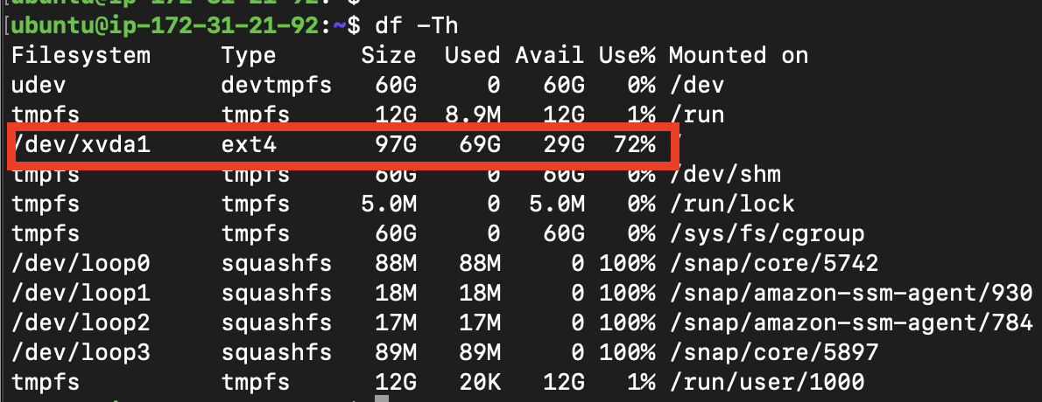
AWS Setup
Reason: We have a really huge dataset (3G), so the first step for this project is to setup an AWS cloud instance with a large enough disk space to run our codes there.
Note: The default disk space of AWS Instance is 72GB, but there is only 3GB is available.

Slide 21
Thank You!
Questions ?

Slide 22
Reference
Balaji, Nikhil. “Image Data Pre-Processing for Neural Networks.” Becoming Human: Artificial Intelligence Magazine, Becoming Human, 11 Sept. 2017, becominghuman.ai/image-data-pre-processing-for-neural-networks-498289068258
Francois Chollet, “Building powerful image classification models using very little data”, June 05, 2016 https://blog.keras.io/building-powerful-image-classification-models-using-very-little-data.html
Karen Simonyan, "Very Deep Convolutional Networks for Large-Scale Image Recognition", Apr 10, 2015 https://arxiv.org/abs/1409.1556

